Slide 1
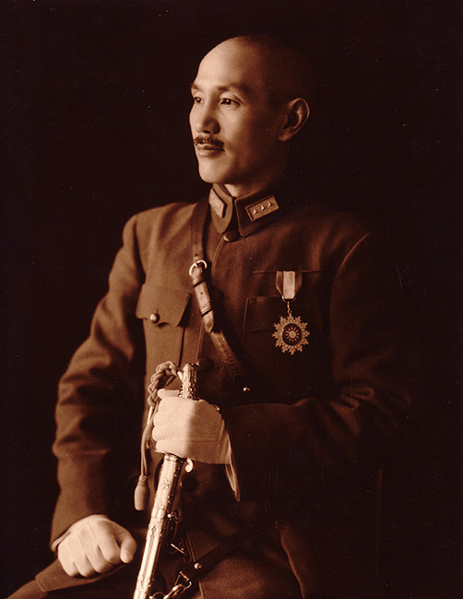
1945-1949: Communist Revolution
In 1921, Mao Zedong formed the first Communist Party. They were in opposition to the ruling Nationalist Party (Kuomintang) who had successfully replaced the Qing Dynasty and ended over 2000 years of dynastic rule in 1912.
The Nationalists tried to defeat Mao who was severely outnumbered. He believed that his success would come by the hands of the peasants in the countryside.
In 1933, Mao led his followers, approximately 100,000 people into the mountains of northwest China to escape defeat. In all, they traveled over 6000 miles in what is known as the Long March.
When the Japanese surrendered, the Nationalists and the Communists began a mad scramble to seize territory that had been occupied by the Japanese. The two sides were not only interested in territory but the arsenals and technology that the Japanese had left behind.
Chiang Kai-shek

Slide 2
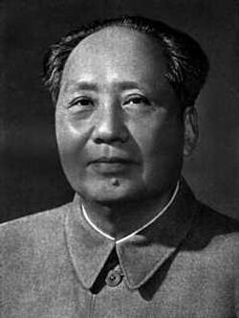
Mao Zedong Takes Control!
The tide had turned in favor of the communists. The Nationalist Army had been spreading its troops thin in the conquered areas, weakening their ability to fight the Red Army (Communists).
The Red Army had been steadily growing all throughout 1946 and 1947 as peasants from all over the countryside joined Mao’s army.
As the Communist army grew, they inflicted heavier and heavier losses on Nationalist forces. In the last year of the civil war, the Nationalists suffered over a million and a half casualties. In the face of such staggering losses, the Nationalist Army simply disintegrated in mid-1949.
On October 1, 1949, Mao declared the establishment of the People's Republic of China. Kai-shek and the Nationalists fled to Formosa (Taiwan) and set up their government there. The conflict still goes on.
Mao-Zedong

Slide 3
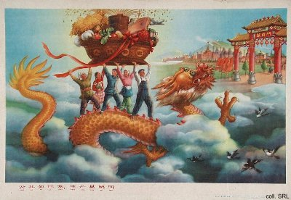
1958: The Great Leap Forward
When Mao took over, he also took over privately owned land. Anyone who opposed was “taken care of.”
The Great Leap Forward took place in 1958. The Great Leap Forward was Mao’s attempt to modernize China’s economy so that China would have an economy that rivaled America.
The Great Leap Forward planned to develop agriculture and industry. Mao believed that both had to grow to allow the other to grow. To allow for this, China was reformed into a series of collectives, or communes.
The size of a collective varied but most contained about 5000 families. The life of an individual was controlled by the collective. Schools, nurseries, and “Houses of Happiness” were provided by the communes so that all adults could work.

Slide 4
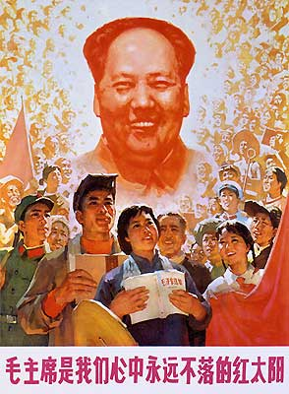
Problems . . .
By the end of 1958, private property had been ruthlessly seized and 700 million people had been placed into collectives.
In 1959, things started to go wrong. Political decisions/beliefs took precedence over common sense and collectives faced the task of doing things which they were not able to accomplish. Collective leaders, who knew what their collective was capable of doing or not, could be charged and imprisoned if he complained.
Quickly produced farm machinery made in factories and backyards fell to pieces when used. Many thousands of workers were injured after working long hours, falling asleep at their jobs, and generally lacking the skills to do their jobs.

Slide 5
1958: China’s Great Leap Forward
The excellent growing weather of 1958 was followed by a very poor growing year in 1959. Some parts of China were hit by floods. In other growing areas, drought was a major problem. In addition, China was exporting grain to Russia for industrial equipment.
1960 had even worse weather than 1959. Nine million people are thought to have starved to death in 1960 alone. Between 1959 and 1962, it is thought that 20-30 million people died of starvation or diseases related to starvation.
Some party members put the blame of the failure of the Great Leap Forward on Mao. He was popular with the people but he still had to resign from his position as Head of State (though he remained in the powerful Party Chairman position).
Great Leap Forward
3 minutes

Slide 6
What to do next?
The day-to-day running of China was left to three men. In late 1960, they abandoned the Great Leap Forward. Ownership of land was given back to individuals and communes were cut down to a manageable size.
These three leaders had cut down on Mao’s power but his reputation among the ordinary Chinese people was still great because he was seen as the leader of the revolution. He was to use this popularity with the people to gain back his authority at the expense of the new leaders. This was in the so-called Cultural Revolution.

Slide 7
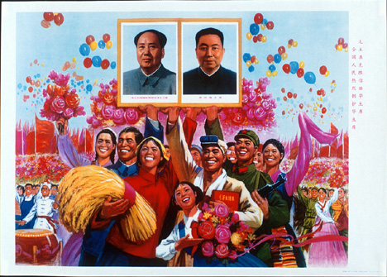
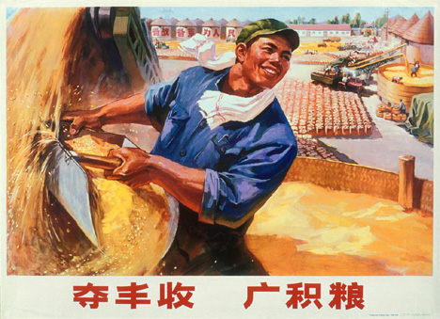
1966-1976: The Chinese Cultural Revolution
In 1966, after spending years studying political economy and the classics of Chinese history, Mao was ready to act.
Mao launched the Cultural Revolution in August of 1966 in front of the Central Committee when he called for Red Guards to challenge Communist Party officials for their lack of revolutionary vision.
Mao and his group of radicals regained full control of the government.

Slide 8
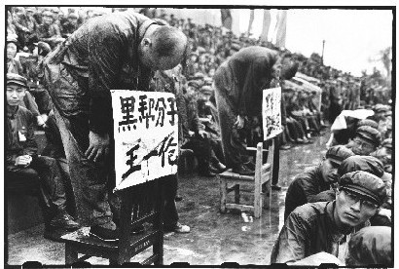
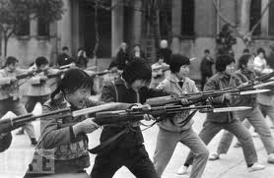
Cultural Revolution cont.
He told students to leave school and make war on anything in Chinese society that encouraged different social classes. They were to revolt against “The Four Olds”: old culture, old habits, old ideas, old customs.
These students were known as Red Guards. It was their job to remove anyone who was preventing China from becoming a true Communist nation.
Business managers, teachers, and even some government officials were singled out. They were put through “struggle sessions” while some were put in prison and still others killed.

Slide 9
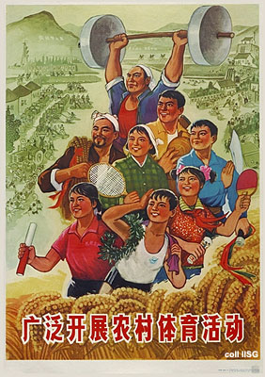
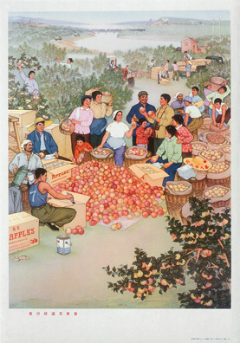
The Changing of the Guard
After years of turmoil and power struggle in China involving offshoots of Mao’s revolutionary group—including the radical group led by Mao’s wife, Jiang Qing, Mao died in September of 1976.
A coalition of army and political leaders united and arrested Jiang Qing and her radical supporters called the Gang of Four.
In 1977, Deng Xiaoping emerges as the supreme leader of the People's Republic of China.
Cultural Revolution and Red Guards
1 ½ minutes

Slide 10
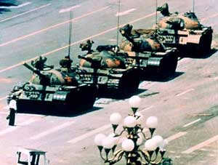
1989: Tiananmen Square
Several hundred civilians were shot by the Chinese army during a bloody military operation to crush a democratic uprising in Peking's (Beijing) Tiananmen Square.
Demonstrators, mainly students, had occupied the square for seven weeks, refusing to move until their demands for democratic reform were met.
The military offensive came after several failed attempts to persuade the protesters to leave. The government warned it would do whatever it saw necessary to clamp down on what it described as "social chaos".
The demonstrations in Tiananmen Square have been described as the greatest challenge to the communist government in China since the 1949 revolution.

Slide 11
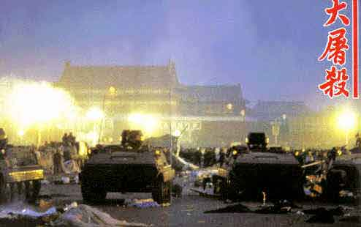
T-Square . . .
Some even say that Communist leader Deng Xiaoping personally ordered the operation as a way of shoring up his leadership.
Hundreds were killed although it is unlikely a precise number will ever be known.
Reports also suggest that much of the violence actually occurred in surrounding areas as opposed to the confrontation at the Square itself.
Peking has since become more widely known as Beijing (the capital).
China, Tiananmen Square
5 ½ minutes

