Slide 1
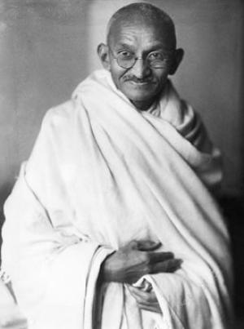
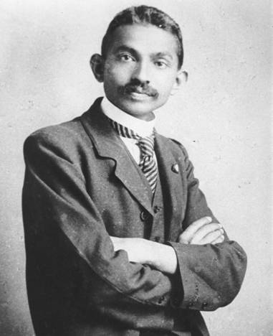
Mohandas Gandhi aka “Mahatma” - “The Great Soul”

Slide 2
Context
-Born in 1869
-Father was Hindu
-Mother believed Jainism – all living things are holy
-He grew up and studied law in London
-His first trial, he was extremely shy & didn’t speak
-Gandhi tried somewhere else – South Africa
-What happened in South Africa?

Slide 3
His return to India
-Extreme poverty
-Strips his suit off and puts on the loin cloth
-Why?
-Self-respect tied to independence, why?

Slide 4
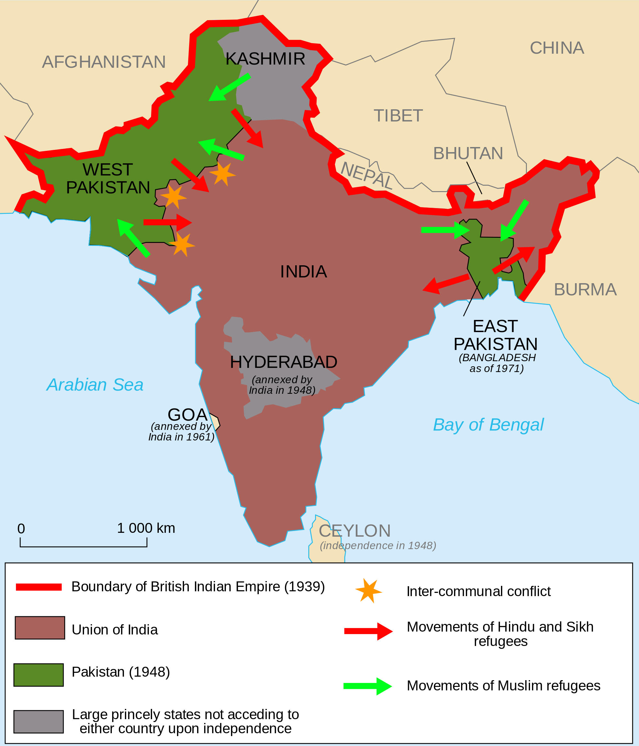
Partitioning of India
-Gandhi feared this partitioning done by Great Britain
-1948
-British wanted to separate religions:
Hindu/Sikhs v. Muslims
-Two groups packed up and went their separate ways. They collided and riots followed. Pakistan and India still don’t have the greatest relationship today
-Kashmir – disputed territory – Why?

Slide 5
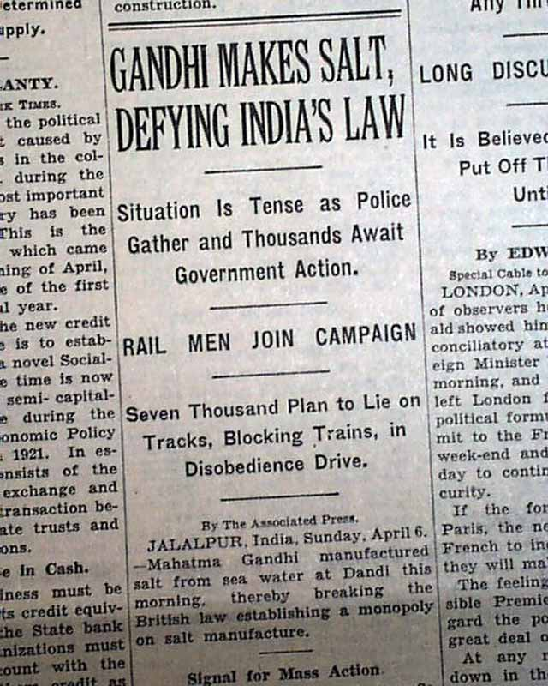
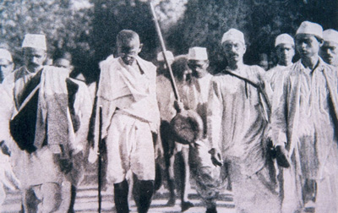
Timeline
Movement 1 – non-cooperation, 1920s
Movement 2 – Civil disobedience (peacefully breaking the law)
Salt March (1930) – HUGE turning point – 240 mi.
“…although by itself it failed to bring Indian Independence, it seriously undermined British authority and united India’s population in a movement for independence under leadership of the Indian National Congress (INC).” –non-violent conflict.org
Movement 3 – Again in the 1940s
India’s independence in 1947
Death of Gandhi – 1948, assassination

