Slide 1
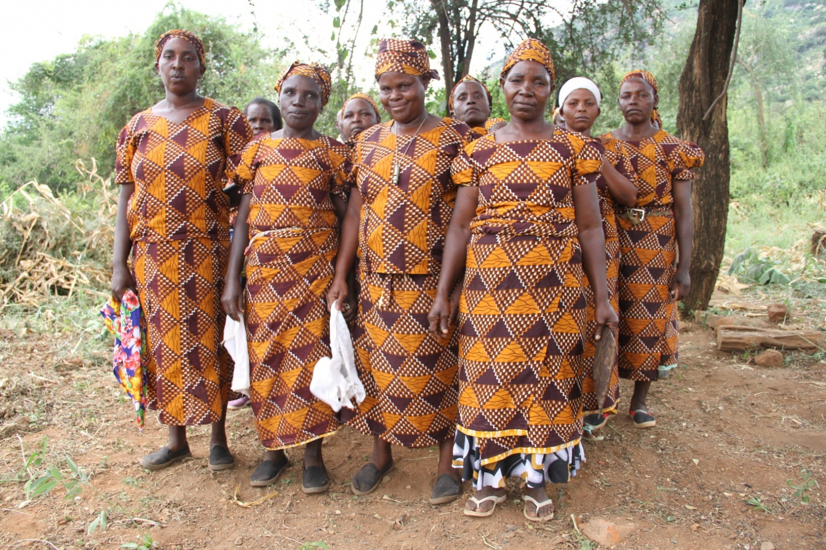
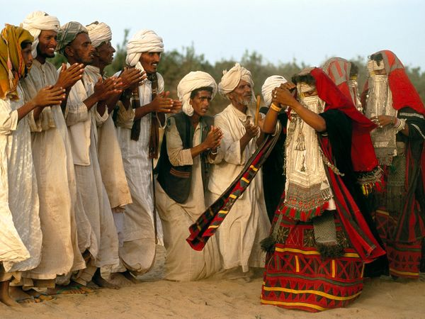
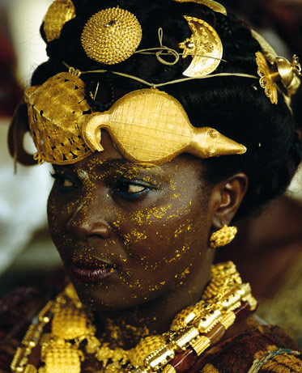
Diversity in Africa
SS7G4

Slide 2
Remember the difference between…
An ethnic group and a religious group?
(Think back to Unit 1 – hint: it’s a part of our vocabulary)

Slide 3
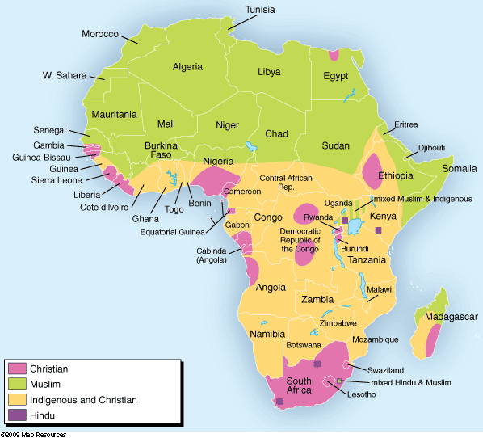
Religious group
-Group of people who share a belief system in god or gods, with a specific set of rituals and literature
Traditional beliefs, like animism belief that all things (living and non-living including natural phenomenon such as wind) have a soul and some of these things may be held up as gods.
Christianity, Islam, Judaism brought over to Africa through trade, colonization, & migration

Slide 4
Ethnic Group
-Group of people who share cultural ideas and beliefs that have been a part of their community for generations.
Language, food, stories, shared history, celebrations
4 primary ethnic groups found in Africa: Ashanti, Arab, Swahili, Bantu

Slide 5
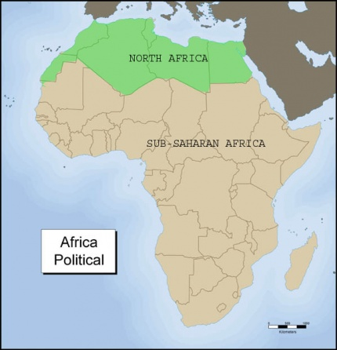
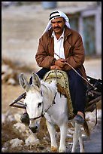
Arabs
Migrated to the North Africa region around 600 AD (Muslim armies arrived in Egypt, remember?)
-From there, Arab armies, traders, scholars spread throughout the region
They took Islam and the Arabic language around with them. However, there are some Arabs in the North Africa region that are followers of Christianity.

Slide 6
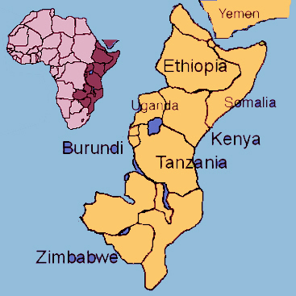
Swahili
Indian Ocean Trade brought religion and language to the eastern coast of Africa
Islam religion
Arabic, Persian, and Bantu language.
Visitors of this new melting pot called these people “Swahili” from Arabic name “sawahil al-sudan” meaning “Shores of the Blacks”

Slide 7
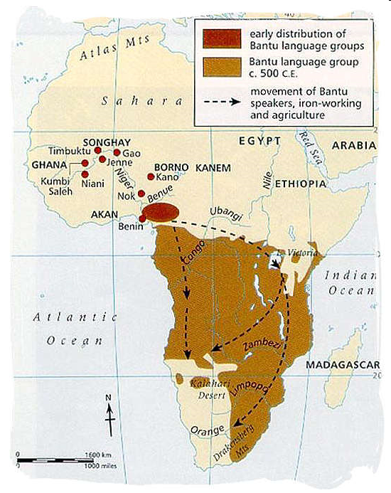
Bantu
One of the original ethnic groups in Africa – began migrating from the Sahara region down to the central and southern parts over 2,000 years ago

Slide 8
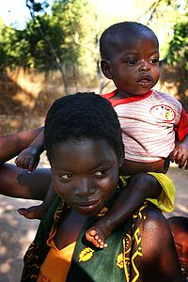
Bantu Migration
More than 300 languages spoken south of the equator can be traced back to the original Bantu peoples.
Today, there are many different ethnic groups that can be traced back to original Bantus.
Many have traditional beliefs (power of ancestors in everyday life).
“Migration by Bantu-Speakers seems like a likely mechanism for the southward spread of iron.” –The Earth and Its People

Slide 9
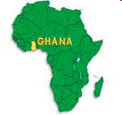
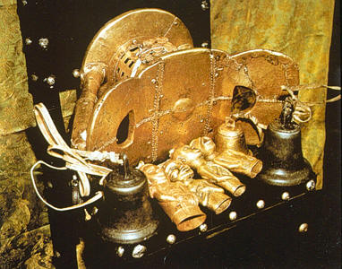
Ashanti
Found in the modern country of Ghana
Founded in 1701 with help of a holy man with a golden stool who then gave it to the first Ashanti king.
According to legend – stool came from the sky and landed in the lap of Osei Tutu
This stool symbolizes the Ashanti power and the kingdom will last as long as the golden stool remains in the hands of the Ashanti king

Slide 10
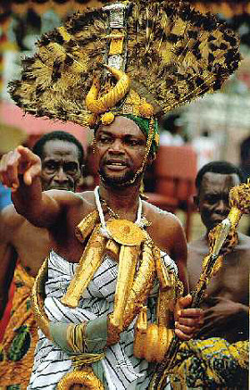
Ashanti continued
Religion is centered on a belief in a supreme god- Nayme
Nayme’s children is believed to represent all the forces in the world
Some Ashanti also practice Christianity & Islam.

