Slide 1
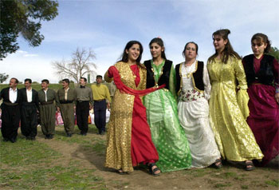
Kurds
Most Kurds are found in the mountainous areas where Syria, Turkey, Iran, and Iraq come together.
They speak their own language called Kurdish, and have a separate history, literature, music, and set of traditions.
Many Kurds hope to have a nation of their own some day, a hope that has caused conflict with the countries in which Kurdish people live.
Most Kurds are Sunni Muslim with small minorities of Shia Muslims and Yazidis.
Women, in traditional Kurdish dress, dance during a wedding party in what they hope to one day be called Kurdistan.

Slide 2
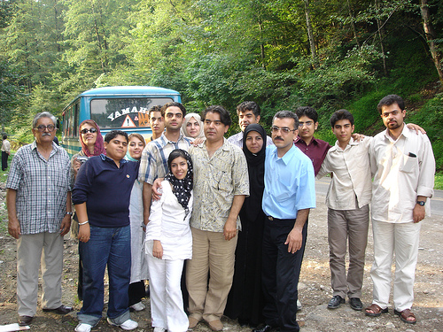
Persians
Most Persians live in the modern country of Iran where they are the most populous ethnic group.
They are different from Arabs and Jews in that their ancestors came from Central Europe and Southern Russia
The country of Persia became known as Iran after WWI.
Persians speak Farsi, a language that uses the Arabic alphabet but is actually spoken differently.
Most Persians are Shia Muslims even though Shia Muslims only make up about 15% of the world’s Muslim population.
Zoroastrianism is one of the minor religions of the Persian people.
Persian family from northern Iran

Slide 3
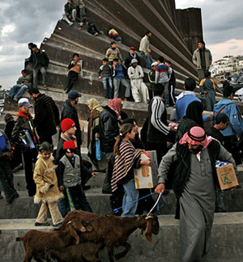
Arabs
Arabs are the most populous ethnic group in the Middle East.
Arabs believe themselves to be descendants of Abraham through his son Ishmael and originally from the Arabian Peninsula.
They speak Arabic.
Most Arabs are Muslims, with the majority being Sunni Muslim. However, there are many Christian Arabs as well, especially in the countries of Lebanon and Egypt.
Arabs escape the Gaza strip into Egypt for much needed supplies.

Slide 4
Arabs continued:
Arabs live everywhere in the Middle East & North Africa
EXCEPT
-Turkey
-Iran
-Where Turkey, Syria, Iran, and Iraq come together

