Slide 1
Warm Up 9/29
On a scratch sheet of paper, write either Palestinians or Israelis – Which do you support?
After, write 3 bullet points/phrases to back up your argument
We will share in 5 minutes! Use your notes for help!

Slide 2
SS7H2c Describe how land and religion are reasons for continuing conflicts in the Middle East.
Concept:
Conflict Creates Change

Slide 3
Vocabulary Words To Know
Arab-Israeli Wars
Camp David Accords
Intifada
Palestinians
P.L.O.
Refugee

Slide 4
ARAB - ISRAELI WARS
series of wars between 1948 and 1973 that were fought between Israel and the Arab countries of Iraq, Syria, Egypt, Jordan, and Lebanon (fought over control of territory in Palestine)

Slide 5
PALESTINIANS
Arabs who live in the region occupied by Israel. They are fighting for independence.

Slide 6
P. L. O.
Palestinian Liberation Organization formed in 1964; organization formed to protect the rights of Palestinians
Yasser Arafat: Most influential leader of the PLO’s history

Slide 7
REFUGEE
a person forced to seek refuge or safety in another country because of war or other political or natural disruption in their home country

Slide 8
INTIFADA
revolt by Palestinian Arabs to protest Israeli occupation of Palestinian-claimed land

Slide 9
CAMP DAVID ACCORDS
1979 peace agreement between Egypt and Israel hosted at Camp David, Maryland by President Jimmy Carter

Slide 10
Conflicts in the Middle East
OVER LAND
Israeli – Arab Wars
Kurds wanting independence from Turkey, Iran, Syria, and Iraq
Iraq invading Iran and later Kuwait for oil
OVER RELIGION
Israeli (Jews) – Arab (Muslims) Wars
Sunni Muslims vs Shi’ites Muslims in Iraq

Slide 11
So, is it Palestine or Israel? Depends on WHEN you ask...
BEFORE 1948
AFTER 1948

Slide 12
Can BOTH flags fly in the same region?
Palestinian – Arab Flag
Israeli – Jewish Flag

Slide 13
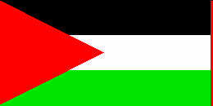
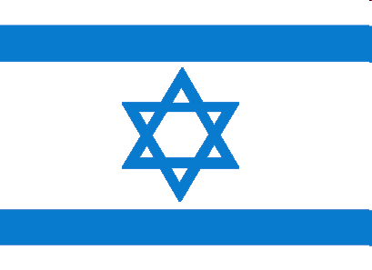
The United Nations in 1947 created a plan to create a Palestinian State and a Jewish State.

Slide 14
So, what has happened between THEN (1947) and NOW (2008)?

Slide 15
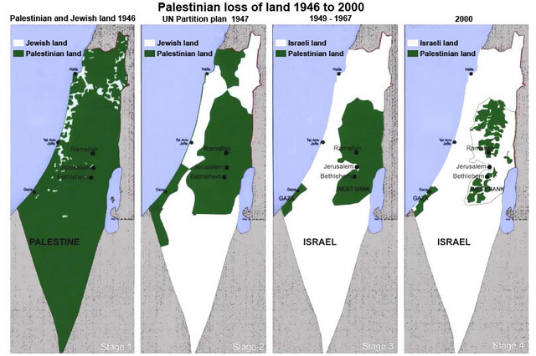
Let’s look at this map again

Slide 16
SS7H2c ESSENTIAL QUESTION Will the fighting between Arabs and Jews over the same holy land ever end?
Concept:
Conflict Creates Change

Slide 17
The name for the armed conflicts between Jews and Arabs in 1948, 1967, and 1973 is known as
ARAB – ISRAELI WARS

Slide 18
Conflict Creates Change & Conflict Resolution
WAR
1948 - Independence War
1956 - Suez Canal Crisis
1967 - Six Days War
1972 - Munich Massacre
1973 - Yom Kippur War
1987 - 1st Intifada
2000 - 2nd Intifada
Countless massacres and suicide bombings
PEACE
1964 – Creation of the PLO
1978 – Camp David Accords
1979 – Israel & Egypt peace treaty
1993 – Oslo Accords
1994 – Israel & Jordan peace treaty

Slide 19
The P.L.O. (Palestine Liberation Organization) was formed to
Yassir Arafat
Protect the rights of Palestinian refugees
Provide political leadership
Get rid of Israel by force
Create a country for the Palestinian Arabs

Slide 20
Why would Israel NOT accept the formula for peace according to the map on the right?

