Slide 1
SS7H1 The student will analyze continuity and change in Africa leading to the 21st century.
Concepts:
Conflict Creates Change
Continuity and Change

Slide 2
The student will understand that while change occurs over time, there is continuity to the basic structure of that society. How has school changed and stayed the same since kindergarten? Why do some things remain the same when society is always changing?
Continuity and Change

Slide 3
The student will understand that when there is conflict between or within societies, change is the result. When you have conflicts with your friends does it change your friendship? Can change have intended and / or unintended consequences? Can change be positive and / or negative?
Conflict Creates Change

Slide 4
SS7H1a Explain how the European partitioning across Africa contributed to conflict, civil war, and artificial political boundaries.
Concepts:
Conflict Creates Change
Continuity and Change

Slide 5
Warm Up 12/7/2015
In 3 or more sentences, summarize, in your own words, the reasons behind European imperialism in Africa. Why would this lead to future conflict?

Slide 6
WARM DECEMBER
Why was there a “Mad Scramble” for European countries to claim African land?
What kind of conflicts could this create?

Slide 7
WARM DECEMBER
According to the map, which two European countries claimed much of the African continent?
What are some conflicts these boundary lines could have created within the African cultures?

Slide 8
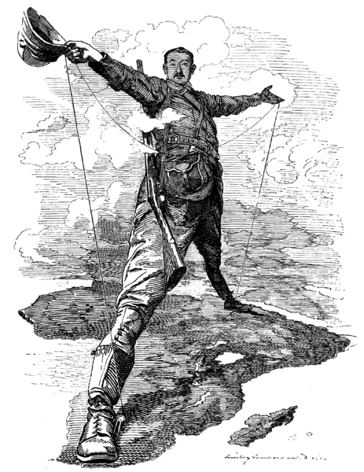
WHAT DO
YOU THINK
THE ARTIST
IS TRYING
TO
COMMUNICATE
IN THIS
POLITICAL
CARTOON?

Slide 9
1884-85 BERLIN CONFERENCE
The Berlin Conference was conducted, and European powers (Great Britain, France, Spain, Portugal, Germany, Belgium, and Italy) agreed to divide the continent into European governed colonies.
This division was disastrous as the new boundary lines divided ethnic groups and in most cases forced rival ethnic groups to live together.
The Europeans wanted the natural resources to fuel the Industrial Revolution. As they made products, they then forced African colonies to buy them for much more than they received for their resources.

Slide 10
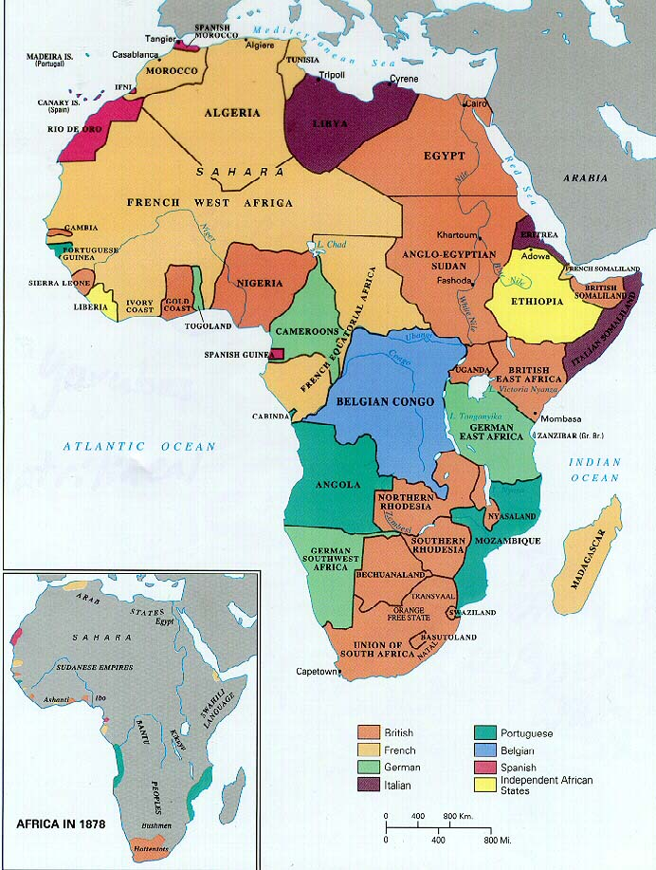
…BUT BY 1885, OVER 90% OF AFRICA WOULD BE UNDER THE CONTROL OF EUROPEAN EMPIRES, PARTICULARLY THE BRITISH AND THE FRENCH
IN 1878,
MUCH OF
AFRICA
WAS NOT
COLONIZED
BY EUROPE

Slide 12
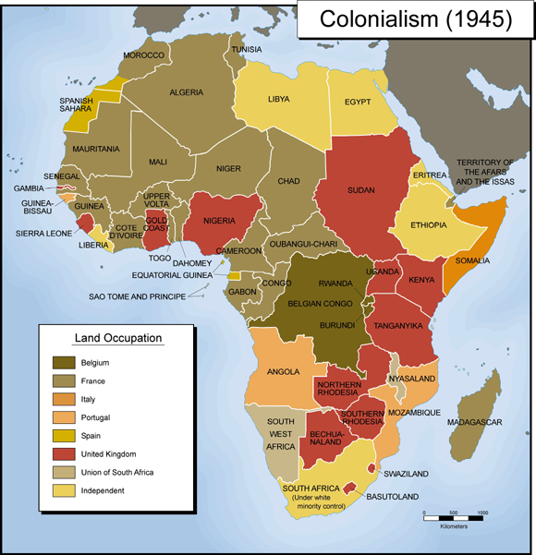

Slide 13
THE 5 W’s of EUROPEAN INFLUENCE IN AFRICA
WHO
(EUROPEAN EMPIRES)
WHAT
(REASONS FOR COLONIZATION)
WHEN
(DEVELOPMENT)
WHERE
(AREAS OF INTEREST)
WHY
(REASONS FOR PARTITIONING)

Slide 14
THE 5 W’s of EUROPEAN INFLUENCE IN AFRICA
WHO
(EUROPEAN EMPIRES)
GREAT BRITAIN
FRANCE
BELGIUM
GERMANY
ITALY
SPAIN
PORTUGAL
WHAT
(REASONS FOR COLONIZATION)
Natural Resources
Nationalism, Competition, Land
New Markets for Europe
Technological advancement
Moral duty
WHEN
(DEVELOPMENT)
1652: Dutch Colony in South Africa
1806: Britain control South Africa and
parts of West Africa
1848: French colonize North Africa
1867: King Leopold II of Belgium
colonizes central Africa
1884: Berlin Conference
1899: Boer War between Dutch
settlers and British military
WHERE
(AREAS OF INTEREST)
Over 90% of Africa came under European control after the Berlin Conference, but the only territories that were not colonized by the European empires were Liberia and Ethiopia.
WHY
(PARTITIONING of AFRICA)
Reacting to the Scramble for Africa, leaders of European empires met in Berlin, Germany to resolve potential conflicts over the control of African colonies. They divided up the land and created new boundary lines without any input by the people of Africa.

Slide 15
The Negatives of Colonialism
Rival ethnic groups forced to live together causing conflicts and wars.
Lost many resources without equal return.
Lost their freedom to govern themselves.
Africans were forced to work on plantations and in mines for very little money.
Children as young as 10 are recruited for civil wars in Africa

Slide 16
Positives of Colonialism
Improved infrastructure: roads and railroads
Improved medical centers
Improved schools
Improved economies –jobs and technology
Democracies allow freedom for many people (except in countries where corruption leads to dictatorships)
Hospitals in South Africa are heavily burdened by HIV- infected children—a leading health issue in Africa.

Slide 17
IMPACT OF COLONIAL RULE ON AFRICA
NEGATIVE IMPACT
Forced Labor
Starvation and Poverty
Disease
Loss of Land and Power
New boundaries separated families and tribes
Civil Wars between ethnic groups
Loss of right to govern themselves
Loss of resources without equal return
POSITIVE IMPACT
Schools and hospitals were built
Improved health care
Roads and railroads were built
New governments and democracy (often led to dictatorships though)
Improved economies / New technologies
End of Slavery

Slide 18
Conflicts in Africa because of artificial political boundaries created by Europeans during the Berlin Conference of 1884-85
Conflict between native Africans and Europeans during colonization
Conflict between ethnic groups
Conflict over who should have political power AFTER Africans gained independence from Europe

Slide 19
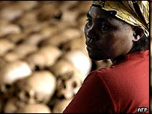
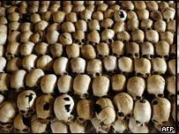
GENOCIDE in RWANDA
1994
A civil war created by European colonization
http://news.bbc.co.uk/1/hi/world/africa/1288230.stm

Slide 20
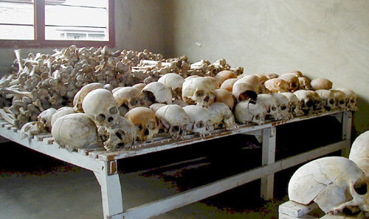
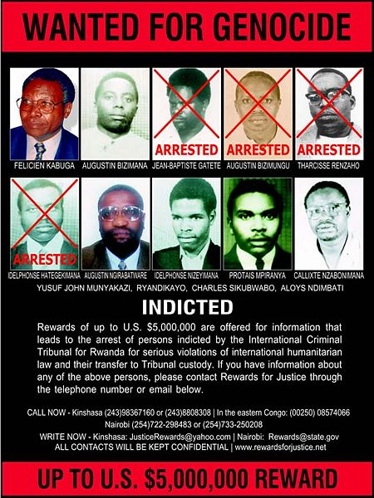
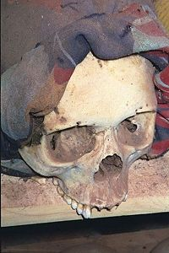
Rwandan Genocide Survivors, 13 min.
RWANDA CONTINUED

Slide 21
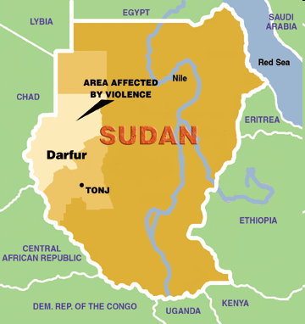
CONFLICT IN DARFUR: A REGION IN WESTERN SUDAN

Slide 22
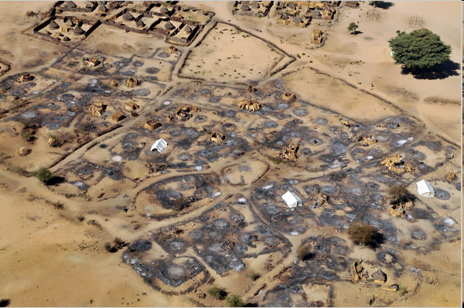
CONFLICT IN DARFUR: A REGION IN WESTERN SUDAN

Slide 23
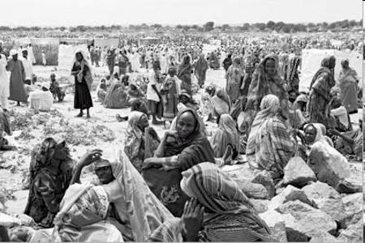
CONFLICT IN DARFUR: A REGION IN WESTERN SUDAN

Slide 24
SS7H1a ESSENTIAL QUESTION How did European partitioning of Africa contribute to conflict, civil war, and artificial political boundaries?
Concept:
Conflict Creates Change
Continuity and Change

