Slide 1
SS7E9a
Explain how specialization encourages trade between countries.

Slide 2
What is specialization?
When a country produces goods and/or services which they can provide best or most efficiently.
How does this encourage trade?
Products are of higher quality usually so they will be in higher demand globally.
If you spend more on just a few products, you will need to trade or buy the things you do not have and your people want/need.

Slide 3
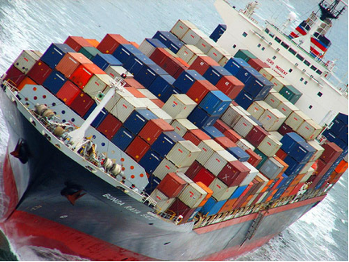
China
China has portions of the country that are almost all agricultural, combining with India to produce the vast majority of the world’s rice. This takes place in East and Southeast China.
In Northeast China, the agricultural products are more cold weather crops such as wheat and grains.
China also produces large amounts of manufactured goods for export for many major companies around the world.

Slide 4
India
India has a growing technological sector.
India also specializes in the service industry. They are home to call centers for over half of the Fortune 500 companies.
A large amount of arable land has enabled India and China to produce over 90% of the world’s rice.

Slide 5
Japan
Japan specializes in manufacturing cars and motorcycles.
In addition, electronics is their major specialization. Say thank you to Japan for your Playstation!

Slide 6
SS7E9b
Compare and contrast different types of trade barriers such as tariffs, quotas, and embargos.

Slide 7
How do we define the types of trade barriers?
Tariff
a tax on imported goods.
Quota
a limit on imported goods
Embargo
a restriction of trade with a certain country or countries.

Slide 8
Why do we use these trade barriers?
Tariff:
A tax may be put on imports as a form of revenue (way to make money)
A tariff on imports may also be used to protect domestic companies.
Quota:
A quota can also be used to protect domestic companies by limiting how many of the cheaper imports come in to your country.
Both of these work because they drive up the price of the imports.

Slide 9
Why do we use these trade barriers?
Embargo:
An embargo is used to influence another country or countries to change their policies or actions by hurting their economy.
Can you think of embargos we’ve discussed this year?
On Iraq when they invaded Kuwait and started the Persian Gulf War in 1991.
On South Africa during their racist policy of Apartheid.
On the United States by OPEC when we supported Israel during the Yom Kippur War in 1973.

Slide 10
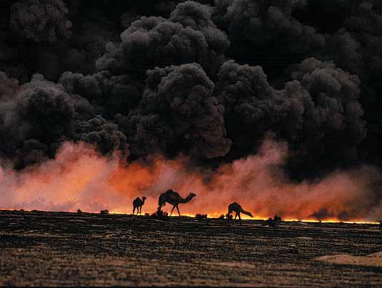
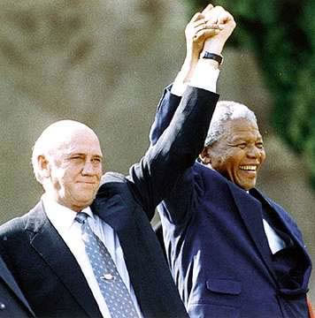
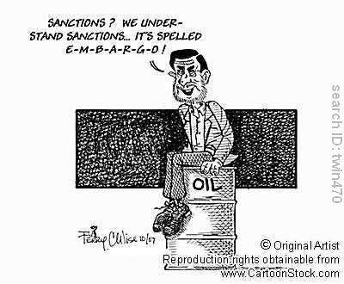

Slide 11
SS7E9c
Explain why international trade requires a system for exchanging currencies between nations.

Slide 12
Currency Exchange
Most countries have their own currency. In order for them to pay for goods as they trade with other countries, they have to have a system of changing from one type of currency to another.
This is known as an exchange rate.
Country | Currency | Equivalent in US dollars
United States | Dollar | $1.00
India | Rupee | 41.5 / dollar
China | Yuan | 7.61 / dollar
Japan | Yen | 117 / dollar
North Korea | Won | 140 / dollar

Slide 13
Mind Map Activity
For the next 30 minutes, you will use the long piece of paper to illustrate your ideas that focus on Trade Barriers of Asia. Be sure to include the following terms:
Tariff
Quota
Embargo
Currency Exchange
Trade Specialization
Be neat, creative, & colorful!

